Slide 1
Cse 316
Full-Stack
Web
Applications

Slide 2


Let’s take stock of what we know
How to make a front-end app
HTML/CSS/JSON
Vanilla JavaScript
class-style components with React
Local storage
How to make a back-end API
MongoDB and Mongoose
Express
Testing with Postman

Slide 3

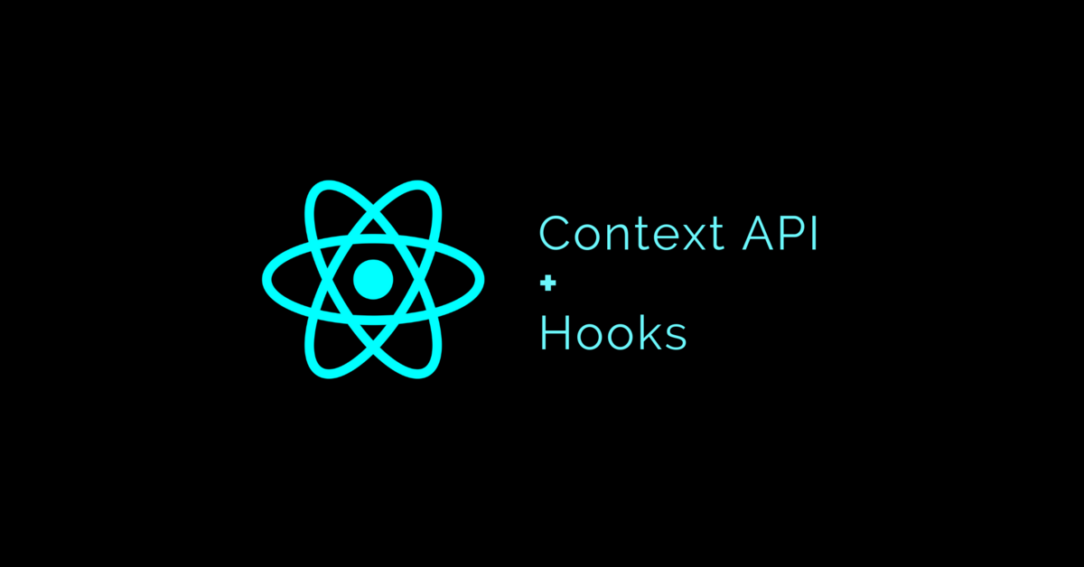
Now it’s time to combine them together
What will we need?
An http request library
Axios
State Management Strategy
Global vs Local
Let’s first review Context & Hooks

Slide 4
Remember Context?
function BlueComponent() {
const {fsc} = useContext(FontSizeContext);
return (
<div style='font-size: {fsc}; color:blue'>
This is Blue and 24 pt
</div>
);
}
function RedComponent() {
const {fsc} = useContext(FontSizeContext);
return (
<div style='font-size: {fsc}; color:red'>
This is Red and 24 pt
</div>
);
}
const FontSizeContext = React.createContext(24);
function App {
return (
<FontSizeContext.Provider value='24'>
<BlueComponent />
<RedComponent />
</FontSizeContext.Provider>
);
}
}

Slide 5
So what are React hook functions again?
Let React components hook into the component lifecycle
Let’s look at some important ones:
useContext
useState
useReducer
useEffect
useParams
useHistory
Note there are many others and your own

Slide 6
useContext
Lets a component retrieve a context
note: a context can store complex objects, i.e. the application’s local data store
function BlueComponent() {
const {fsc} = useContext(FontSizeContext);
return (
<div style='font-size: {fsc}; color:blue'>
This is Blue and 24 pt
</div>
);
}

Slide 7
useState
Lets a component have its own state variable
returns an array with 2 things: the variable and its setter
we’ll use this for interactivity-type stuff, like isDragging, editing text, etc.
Note that setState forces a re-render of this component
function CounterToggle() {
const [counter, setCounter] = useState(0);
function handleClick(evt) { setCounter(counter+1); }
return (
<div onClick={handleClick}>
{counter}
</div>
);
}

Slide 8
Ever hear of a reducer?
currentState, action
dispatch
function
Reducer
A purely functional object
called by a dispatch method
for each input, it returns output
maintains no state of its own
Input is 2 objects:
current state
action, which itself has 2 objects:
type
payload (i.e. the data associated with the action
Output, i.e. what it returns, is the updated state
What’s the point? A reducer defines all rules and mechanisms for updating state
newState
Note: Reducers should not have complicated logic, like how to talks to the back-end API

Slide 9
useReducer Example
import {useReducer} from 'react'
function CounterToggle() {
const [counter, dispatch] = useReducer(myReducer, 0);
function inc() { dispatch({type:'inc', payload:1});}
function dec() { dispatch({type:'dec', payload:1});}
return (
<div>
<div onClick={inc}>++</div>
<div onClick={dec}>--</div>
Counter: {counter}
</div>
);
}
function myReducer(prevState, action) {
switch(action.type) {
case "inc":
return prevState + action.payload;
default:
return prevState - action.payload;
}
}
function App() {
return (
<CounterToggle />
);
}

Slide 10
useEffect
Called on a component after rendering
be careful changing state
Takes 2 arguments:
your callback function to execute
dependencies
If your dependencies is an empty array [], it will only be called once, upon first mounting/rendering

Slide 11
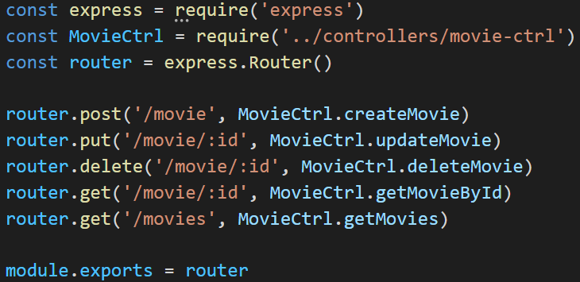
A note about routing
We have already covered back-end API routing with Express

Slide 12
There is also front-end routing
import { BrowserRouter, Route, Switch } from 'react-router-dom’
What’s the point?
we’re making a Single Page Application
React’s router library manages virtual routing
ensures front-end requests are on proper routes
React Routes need 2 things:
path (should correspond to paths the back-end is expecting)
should sometimes include an id (like for a MongoDB document)
component(s)

Slide 13
Example using React Router
import { BrowserRouter as Router, Route, Switch } from 'react-router-dom'
const App = () => {
return (
<Router>
<div>My Banner</div>
<Switch>
<Route path="/" exact component={MovieLister} />
<Route path="/movie/:id" exact component={MovieEditor} />
</Switch>
<div>My Statusbar</div>
</Router>
)
}

Slide 14
How does an application get a “route”?
Either via a Link
ex: <Link to='./movie/' + {movie._id}>{movie.name}</Link>
OR
Pushing directly to history
after an event is triggered, like for dynamically jumping routes
const history = useHistory();
…
history.push('./movie/' + {movie._id});

Slide 15
useParams
Gets path params, like id
// FOR OUR /movie/:id PATH, id IS A PARAM
const {id} = useParams();
…
// NOW OUR COMPONENT KNOWS THE ID AND
// CAN DO SOMETHING WITH IT

Slide 16
But we’re still not doing front-end/back-end communication
We need additional libraries
What must they do?
send requests
get responses
do these things using formatted data we can understand
our own JSON objects
Low-level libraries: AJAX and Fetch
Higher-level library: Axios

Slide 17
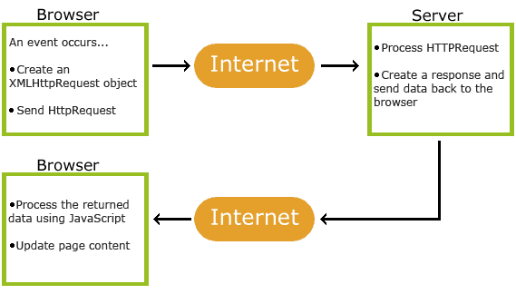
AJAX was the low-level way to do Request/Response

Slide 18
Fetch API is now the Request/Response standard
Promise-based, which helps with things like asynchronous retrieval
async function postData(url = '', data = {}) {
const response = await fetch(url, {
method: 'POST',
mode: 'cors',
cache: 'no-cache',
credentials: 'same-origin',
headers: {
'Content-Type': 'application/json'
},
redirect: 'follow’, referrerPolicy: 'no-referrer', body: JSON.stringify(data)
});
return response.json(); // parses JSON response into native JavaScript objects
}

Slide 19
But we want something easier to use: Axios
import axios from 'axios'
const api = axios.create({
baseURL: 'http://localhost:3000/api',
})
export const insertMovie = payload => api.post(`/movie`, payload)
export const getAllMovies = () => api.get(`/movies`)
export const updateMovieById = (id, payload) => api.put(`/movie/${id}`, payload)
export const deleteMovieById = id => api.delete(`/movie/${id}`)
export const getMovieById = id => api.get(`/movie/${id}`)

Slide 20
We can now add a movie to the database
handleIncludeMovie = async () => {
const { name, rating, time } = this.state
const arrayTime = time.split('/')
const payload = { name, rating, time: arrayTime }
await api.insertMovie(payload).then(res => {
window.alert(`Movie inserted successfully`)
this.setState({
name: '',
rating: '',
time: '',
})
})
}

Slide 21
We can get a movie and everything else
function handleGetMovie(id) {
async function getMovie(id) {
const response = await api.getMovieById(id);
if (response.data.success) {
let name = response.data.data.name;
console.log("We got the movie!");
}
}
getMovie(id);
}

Slide 22
response.data.data.name? Remember our server api
getMovieById = async (req, res) => {
await Movie.findOne({ _id: req.params.id }, (err, movie) => {
if (err) {
return res.status(400).json({ success: false, error: err })
}
return res.status(200).json({ success: true, data: movie })
}).catch(err => console.log(err))
}

Slide 23
So let’s come up with a client architecture
First a directory structure:
/client
//api – all of our axios calls here
//common – 3rd party libraries like jsTPS
//components – all functional React components
//store – manages state globally (makes api calls)
//transactions – all transaction definitions
App.js

Slide 24
./store/index.js manages global state
GlobalStoreContext - create it here
…
GlobalStoreActionType - types of actions
…
useGlobalStore - gets the store as a state
…
storeReducer - our reducer for updating the state
…
store.ABC = function( - functions for updating state

Slide 25
export const useGlobalStore = () => {
const [store, setStore] = useState({
idNamePairs: [],
…
});
const storeReducer = (action) => {
const { type, payload } = action;
switch (type) {
case GlobalStoreActionType.LOAD_ID_NAME_PAIRS: {
return setStore({
idNamePairs: payload,
…
});
}
…
}
}

Slide 26
…
store.refreshIdNameListPairs = function () {
async function fetchIdNameListPairs() {
const response = await api.getTop5ListPairs();
if (response.data.success) {
let pairsArray = response.data.idNamePairs;
storeReducer({
type: GlobalStoreActionType.LOAD_ID_NAME_PAIRS,
payload: pairsArray
});
}
else {
console.log("API FAILED TO GET THE LIST PAIRS");
}
}
fetchIdNameListPairs();
}
…

Slide 27
Now our components can use the store
import { GlobalStoreContext } from '../store'
const ListSelector = () => {
const { store } = useContext(GlobalStoreContext);
store.history = useHistory();
useEffect(() => {
store.refreshIdNameListPairs();
}, []);
…

Slide 28


import { GlobalStoreContext, useGlobalStore } from './store'
const AppWrapper = () => {
const store = useGlobalStore();
return (
<GlobalStoreContext.Provider value={store}>
<App />
</GlobalStoreContext.Provider>
)
}
ReactDOM.render(
<React.StrictMode>
<AppWrapper />
</React.StrictMode>,
document.getElementById('root')
);

Slide 29
Now you can make a full-stack web application!
What are we missing?
Accounts
Security
Users owning content

